Slide 1
COMP 3500 Introduction to Operating Systems Paging: Translation Look-aside Buffers (TLB)
Dr. Xiao Qin
Auburn University http://www.eng.auburn.edu/~xqin
xqin@auburn.edu
Slides are adopted and modified from materials developed by Drs. Silberschatz, Galvin, and Gagne

Slide 2
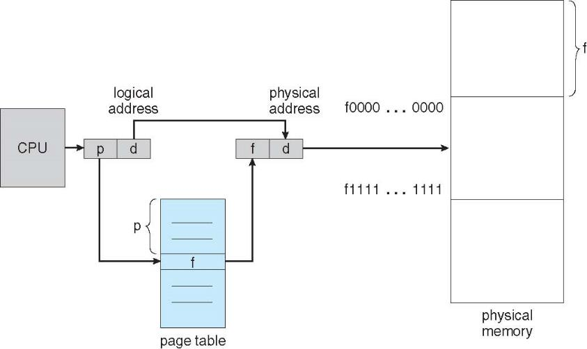
Review: Logical-to-Physical Address Translations

Slide 3
Review: Two registers to support paging
Where should we keep page tables?
Where does the Page-table base register (PTBR) point at?
The Page-table length register (PTLR) indicates size of the page table.
Notes:
Main memory
Table table.

Slide 4
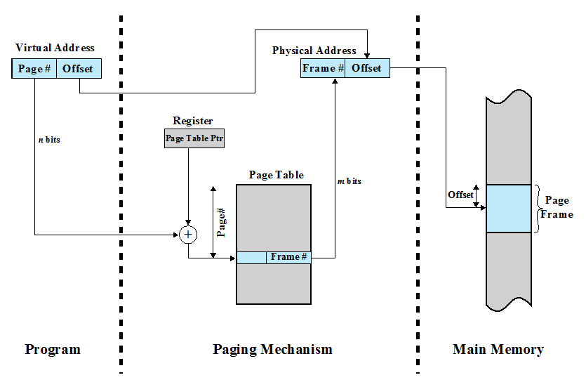
Page-table Base Register (Page Table Pointer)

Slide 5
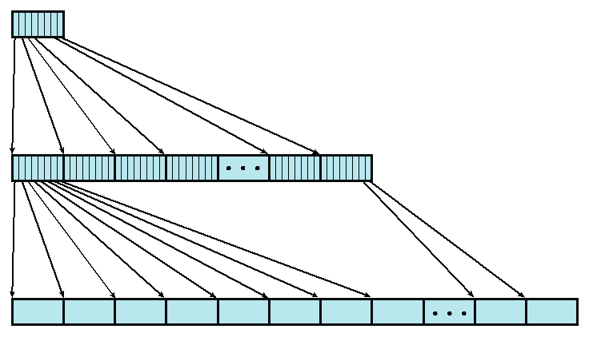
Ex1: Two-Level Page Table
4KB root page table
Assume (1) we have 4-byte page table entry. (2) page size is 4KB
1. How many root page table entries?
User Page Table
2. How many user page table entries?
3. How large is the user address space?
Notes:
An example of a two-level scheme typical for use with a
32-bit address. If we assume byte-level addressing and 4-kbyte (2 ¹² ) pages, then the
4-Gbyte (2 ³² ) virtual address space is composed of 2 ²⁰ pages. If each of these pages
is mapped by a 4-byte page table entry, we can create a user page table composed of
2 ²⁰ PTEs requiring 4 Mbytes (2 ²² ). This huge user page table, occupying 2 ¹⁰ pages,
can be kept in virtual memory and mapped by a root page table with 2 ¹⁰ PTEs occupying
4 Kbyte (2 ¹² ) of main memory.

Slide 6
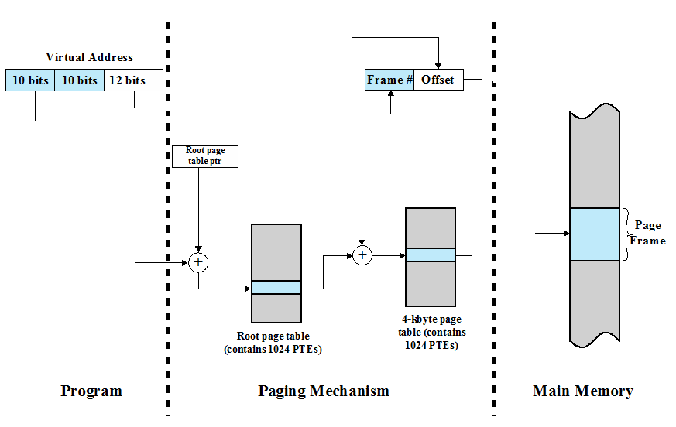
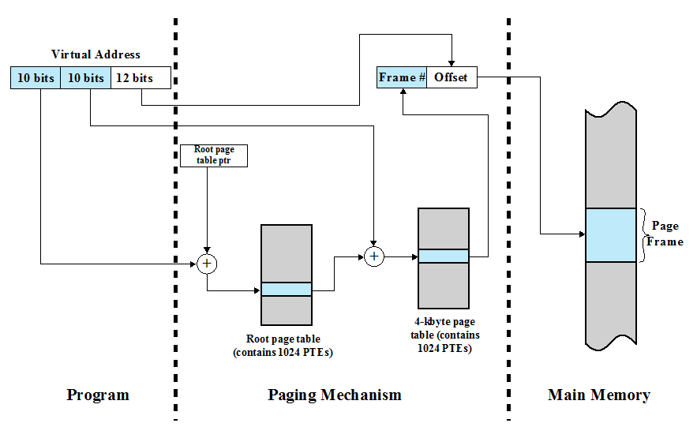
Ex2: Address Translation in the Two-Level Paging System

Slide 7
Ex3: Design virtual address format for a two-level paging system
Suppose you design a two-level page translation scheme where page size is 16MB and page table entry size is 16 bytes.
What is the format of a 64-bit virtual address?

Slide 8
Ex4: Memory Accesses in the Paging Scheme
To load an instruction or data from main memory, how many memory accesses are required in the paging scheme?
two memory accesses
One for the page table and one for the data / instruction
What is the problem with respect to memory access?
The two memory access problem can be solved by the use of a special fast-lookup hardware cache called associative memory or translation look-aside buffers (TLBs)

Slide 9
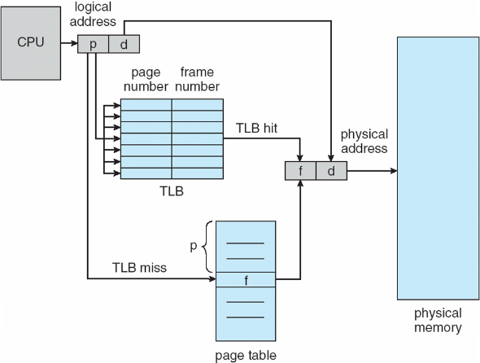
Paging Hardware with Translation Look-aside Buffers (TLB)
Q2: Why TLBs are typically small (64 to 1,024 entries)?

Slide 10
Parallel Searching the TLB
How to search TLB?
Associative memory: parallel search
Address translation (p, d)
If p is in associative register, get frame # out
Otherwise get frame # from page table in memory

Slide 11
Address Space ID in TLBs
Q1: Why some TLBs store address-space identifiers (ASIDs) in each TLB entry – uniquely identifies each process?
To provide address-space protection for that process

Slide 12
Q2: What happens on a TLB miss?
Value (?) is loaded into the TLB for faster access next time
Replacement policies must
be considered
Notes:
What value? (page#, frame#) in the page table.
Replacement policies must be considered
Some entries can be wired down for permanent fast access

Slide 13
Effective Memory Access Time
Associative Lookup = Ttlb time unit
TLB hit ratio = h
percentage of times that a page number is found in the associative registers;
T_hit = T_tlb + T_mem
T_miss = T_tlb + T_mem + T_tlb_update + T_mem
access page table
access data
T_miss = T_tlb + T_mem + T_mem
Effective Access Time = h*T_hit + (1-h)*T_miss
Notes:
TLB update and accessing data in memory are performed in parallel
T_tlb_update << T_mem
Associative Lookup = Ttlb time unit
Can be < 10% of memory access time
Hit ratio = h
Hit ratio – percentage of times that a page number is found in the associative registers; ratio related to number of associative registers

Slide 14
Ex5: Effective Access Time
Consider a single-level paging scheme. The TLB has 32 entries. The TLB access time is 10 ns; memory access time is 200ns.
How long does it take to access data in memory if there is a TLB hit?
How long does it take to access data in memory if there is a TLB miss?
What is the effective memory-access time if we have a TLB hit ratio of 80%?
What is the minimal hit ratio that guarantees the effective access time of at most 220ns?

Slide 15
Summary
Page-table Base Register
Two-Level Page Table
Address Translation in a Two-Level Paying System
Translation Look-aside Buffers (TLBs)
Effective Memory Access Time

Slide 16
Memory Protection
Memory protection implemented by associating protection bit with each frame to indicate if read-only or read-write access is allowed
Can also add more bits to indicate page execute-only, and so on
Valid-invalid bit attached to each entry in the page table:
“valid” indicates that the associated page is in the process’ logical address space, and is thus a legal page
“invalid” indicates that the page is not in the process’ logical address space
Or use page-table length register (PTLR)
Any violations result in a trap to the kernel

Slide 17
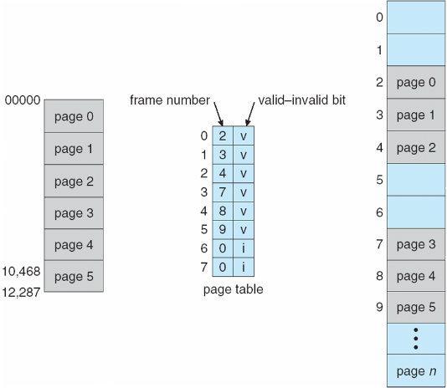
Valid (v) or Invalid (i) Bit In A Page Table

Slide 18
Shared Pages
Shared code
One copy of read-only (reentrant) code shared among processes (i.e., text editors, compilers, window systems)
Similar to multiple threads sharing the same process space
Also useful for interprocess communication if sharing of read-write pages is allowed
Private code and data
Each process keeps a separate copy of the code and data
The pages for the private code and data can appear anywhere in the logical address space

Slide 19
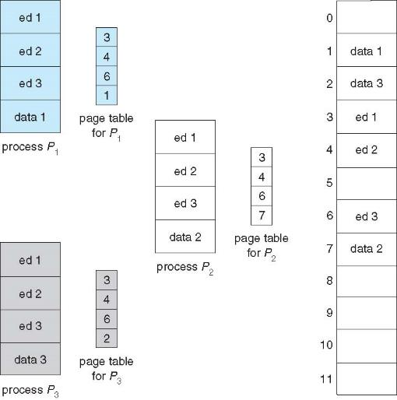
Shared Pages Example

Slide 20
Structure of the Page Table
Memory structures for paging can get huge using straight-forward methods
Consider a 32-bit logical address space as on modern computers
Page size of 4 KB (2¹²)
Page table would have 1 million entries (2³² / 2¹²)
If each entry is 4 bytes -> 4 MB of physical address space / memory for page table alone
That amount of memory used to cost a lot
Don’t want to allocate that contiguously in main memory
Hierarchical Paging
Hashed Page Tables
Inverted Page Tables

Slide 21
Hierarchical Page Tables
Break up the logical address space into multiple page tables
A simple technique is a two-level page table
We then page the page table

Slide 22
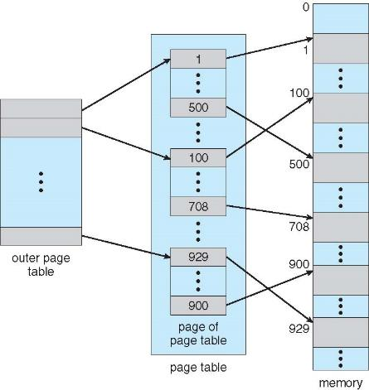
Two-Level Page-Table Scheme

Slide 23
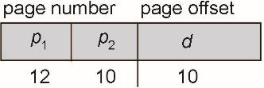
Two-Level Paging Example
A logical address (on 32-bit machine with 1K page size) is divided into:
a page number consisting of 22 bits
a page offset consisting of 10 bits
Since the page table is paged, the page number is further divided into:
a 12-bit page number
a 10-bit page offset
Thus, a logical address is as follows:
where p₁ is an index into the outer page table, and p₂ is the displacement within the page of the inner page table
Known as forward-mapped page table

Slide 24
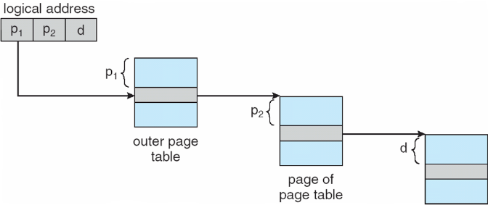
Address-Translation Scheme

Slide 25
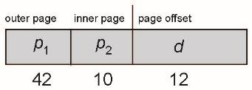
64-bit Logical Address Space
Even two-level paging scheme not sufficient
If page size is 4 KB (2¹²)
Then page table has 2⁵² entries
If two level scheme, inner page tables could be 2¹⁰ 4-byte entries
Address would look like
Outer page table has 2⁴² entries or 2⁴⁴ bytes
One solution is to add a 2nd outer page table
But in the following example the 2nd outer page table is still 2³⁴ bytes in size
And possibly 4 memory access to get to one physical memory location

Slide 26
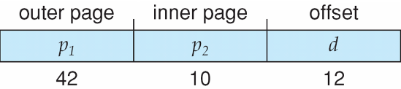
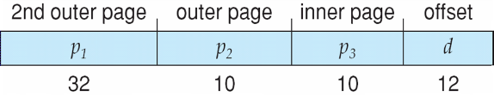
Three-level Paging Scheme

Slide 27
Hashed Page Tables
Common in address spaces > 32 bits
The virtual page number is hashed into a page table
This page table contains a chain of elements hashing to the same location
Each element contains (1) the virtual page number (2) the value of the mapped page frame (3) a pointer to the next element
Virtual page numbers are compared in this chain searching for a match
If a match is found, the corresponding physical frame is extracted
Variation for 64-bit addresses is clustered page tables
Similar to hashed but each entry refers to several pages (such as 16) rather than 1
Especially useful for sparse address spaces (where memory references are non-contiguous and scattered)

Slide 28
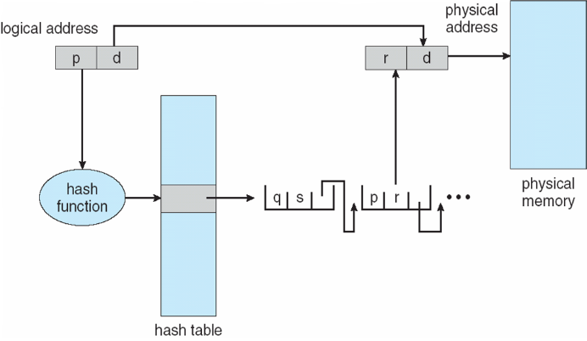
Hashed Page Table

Slide 29
Inverted Page Table
Rather than each process having a page table and keeping track of all possible logical pages, track all physical pages
One entry for each real page of memory
Entry consists of the virtual address of the page stored in that real memory location, with information about the process that owns that page
Decreases memory needed to store each page table, but increases time needed to search the table when a page reference occurs
Use hash table to limit the search to one — or at most a few — page-table entries
TLB can accelerate access
But how to implement shared memory?
One mapping of a virtual address to the shared physical address

Slide 30
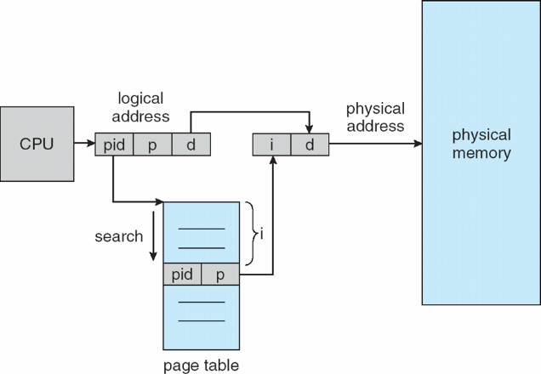
Inverted Page Table Architecture

Slide 31
Oracle SPARC Solaris
Consider modern, 64-bit operating system example with tightly integrated HW
Goals are efficiency, low overhead
Based on hashing, but more complex
Two hash tables
One kernel and one for all user processes
Each maps memory addresses from virtual to physical memory
Each entry represents a contiguous area of mapped virtual memory,
More efficient than having a separate hash-table entry for each page
Each entry has base address and span (indicating the number of pages the entry represents)

Slide 32
Oracle SPARC Solaris (Cont.)
TLB holds translation table entries (TTEs) for fast hardware lookups
A cache of TTEs reside in a translation storage buffer (TSB)
Includes an entry per recently accessed page
Virtual address reference causes TLB search
If miss, hardware walks the in-memory TSB looking for the TTE corresponding to the address
If match found, the CPU copies the TSB entry into the TLB and translation completes
If no match found, kernel interrupted to search the hash table
The kernel then creates a TTE from the appropriate hash table and stores it in the TSB, Interrupt handler returns control to the MMU, which completes the address translation.

Slide 33
Example: The Intel 32 and 64-bit Architectures
Dominant industry chips
Pentium CPUs are 32-bit and called IA-32 architecture
Current Intel CPUs are 64-bit and called IA-64 architecture
Many variations in the chips, cover the main ideas here

Slide 34
Example: The Intel IA-32 Architecture
Supports both segmentation and segmentation with paging
Each segment can be 4 GB
Up to 16 K segments per process
Divided into two partitions
First partition of up to 8 K segments are private to process (kept in local descriptor table (LDT))
Second partition of up to 8K segments shared among all processes (kept in global descriptor table (GDT))

Slide 35

Example: The Intel IA-32 Architecture (Cont.)
CPU generates logical address
Selector given to segmentation unit
Which produces linear addresses
Linear address given to paging unit
Which generates physical address in main memory
Paging units form equivalent of MMU
Pages sizes can be 4 KB or 4 MB

Slide 36

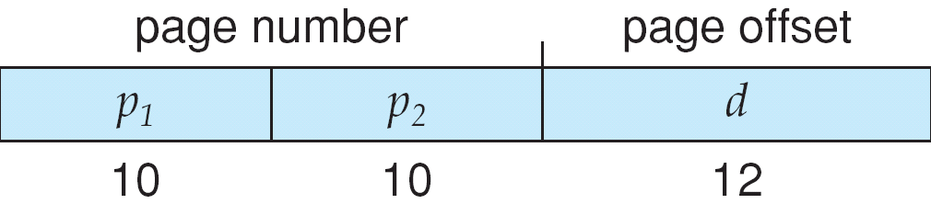
Logical to Physical Address Translation in IA-32

Slide 37
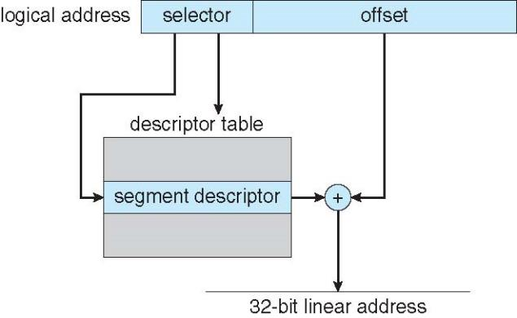
Intel IA-32 Segmentation

Slide 38
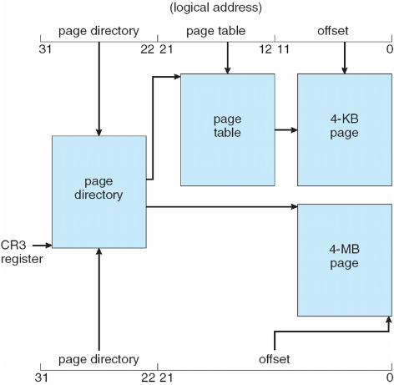
Intel IA-32 Paging Architecture

Slide 39
Intel IA-32 Page Address Extensions
32-bit address limits led Intel to create page address extension (PAE), allowing 32-bit apps access to more than 4GB of memory space
Paging went to a 3-level scheme
Top two bits refer to a page directory pointer table
Page-directory and page-table entries moved to 64-bits in size
Net effect is increasing address space to 36 bits – 64GB of physical memory

Slide 40
Intel x86-64
Current generation Intel x86 architecture
64 bits is ginormous (> 16 exabytes)
In practice only implement 48 bit addressing
Page sizes of 4 KB, 2 MB, 1 GB
Four levels of paging hierarchy
Can also use PAE so virtual addresses are 48 bits and physical addresses are 52 bits

Slide 41
Example: ARM Architecture
Dominant mobile platform chip (Apple iOS and Google Android devices for example)
Modern, energy efficient, 32-bit CPU
4 KB and 16 KB pages
1 MB and 16 MB pages (termed sections)
One-level paging for sections, two-level for smaller pages
Two levels of TLBs
Outer level has two micro TLBs (one data, one instruction)
Inner is single main TLB
First inner is checked, on miss outers are checked, and on miss page table walk performed by CPU

